Slide 1

PSYLIQ – DATA ANALYST INTERNSHIP
DIABETES PREDICTION ASSESSMENT
Author : Pranav Dharpure

Slide 2
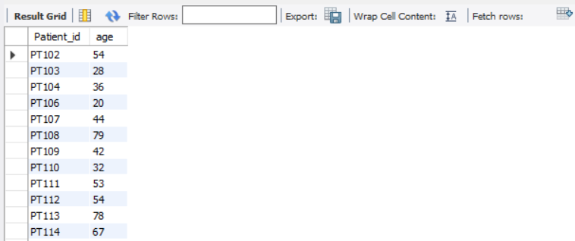
Retrieve the Patient_id and ages of all patients.
SELECT Patient_id, age FROM patient;

Slide 3

2. Select all female patients who are older than 40.
SELECT EmployeeName, Patient_id, gender, age
FROM patient
WHERE gender = 'Female' AND age > 40;

Slide 4
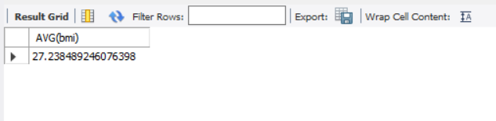
3. Calculate the average BMI of patients.
SELECT AVG(bmi) FROM patient;

Slide 5

4. List patients in descending order of blood glucose levels.
SELECT EmployeeName, Patient_id, blood_glucose_level
FROM patient
ORDER BY blood_glucose_level DESC;

Slide 6

5. Find patients who have hypertension and diabetes.
SELECT EmployeeName, Patient_id, hypertension, diabetes
FROM patient
WHERE hypertension = 1 AND diabetes = 1;

Slide 7

6. Determine the number of patients with heart disease.
SELECT COUNT(Patient_id) AS No_of_heart_patients
FROM patient
WHERE heart_disease = 1;

Slide 8

7. Group patients by smoking history and count how many smokers and nonsmokers there
are.
SELECT
CASE
WHEN smoking_history IN ('current', 'former', 'ever') THEN 'Smoker'
WHEN smoking_history = 'never' THEN 'Non-smoker'
ELSE 'Unknown’
END AS smoking_status, COUNT(*) AS patient_count
FROM patient
WHERE smoking_history IN ('never', 'No Info', 'current', 'former', 'ever', 'not current’)
GROUP BY smoking_status;

Slide 9
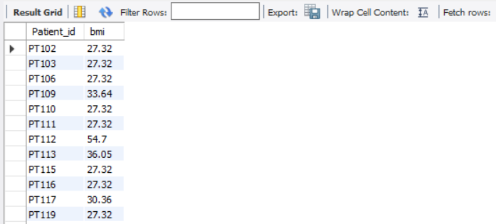
8. Retrieve the Patient_ids of patients who have a BMI greater than the average BMI.
SELECT Patient_id, bmi
FROM patient
WHERE bmi > (SELECT AVG(bmi) FROM patient);

Slide 10

9. Find the patient with the highest HbA1c level and the patient with the lowest HbA1clevel.
SELECT EmployeeName, Patient_id, HbA1c_level
FROM patient
WHERE HbA1c_level = (SELECT MAX(HbA1c_level) FROM patient)
UNION ALL
SELECT EmployeeName, Patient_id, HbA1c_level
FROM patient
WHERE HbA1c_level = (SELECT MIN(HbA1c_level) FROM patient);

Slide 11
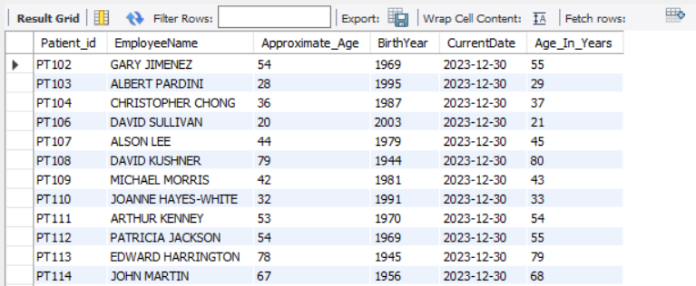
10. Calculate the age of patients in years (assuming the current date as of now).
SELECT Patient_id, EmployeeName, Age AS Approximate_Age,
FLOOR(YEAR(CURDATE()) - Age) AS BirthYear,
CURDATE() AS CurrentDate,
FLOOR(DATEDIFF(CURDATE(),
STR_TO_DATE(CONCAT(YEAR(CURDATE()) - Age, '-01-01'), '%Y-%m-%d')) / 365) AS Age_In_Years
FROM patient;

Slide 12
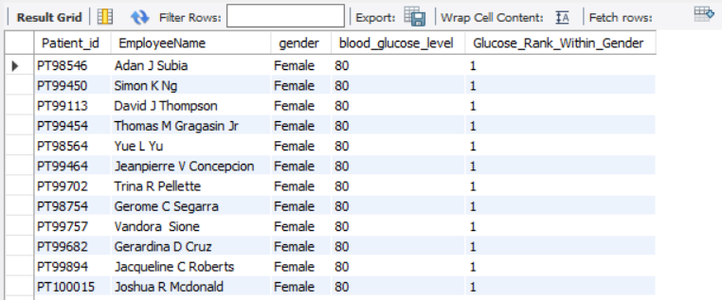
11. Rank patients by blood glucose level within each gender group.
SELECT Patient_id, EmployeeName, gender, blood_glucose_level,
RANK() OVER (PARTITION BY Gender ORDER BY blood_glucose_level) AS Glucose_Rank_Within_Gender
FROM patient;

Slide 13
12. Update the smoking history of patients who are older than 50 to "Ex-smoker.“
UPDATE patient
SET smoking_history = 'Ex-smoker’
WHERE age > 50;

Slide 14
13. Insert a new patient into the database with sample data.
INSERT INTO patient
(Patient_id, EmployeeName, gender, age, smoking_history, blood_glucose_level)
VALUES (1, 'John Doe', 'Male', 35, 'Non-smoker', 120),
(2, 'Jane Smith', 'Female', 45, 'Current smoker', 140),
-- Add more sample data as needed
(3, 'Sam Johnson', 'Male', 55, 'Former smoker', 130);

Slide 15
14. Delete all patients with heart disease from the database.
DELETE FROM patientWHERE heart_disease = 1;

Slide 16
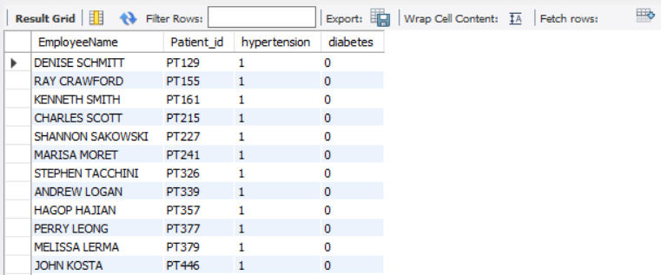
15. Find patients who have hypertension but not diabetes using the EXCEPT operator.
SELECT EmployeeName, Patient_id, hypertension, diabetes
FROM patient
WHERE Hypertension = 1
AND NOT EXISTS (
SELECT 1 FROM patient AS p2 WHERE p2.Patient_id = patient.Patient_id AND p2.diabetes = 1);

Slide 17
16. Define a unique constraint on the "patient_id" column to ensure its values are unique.
ALTER TABLE patient
ADD CONSTRAINT unique_Patient_id UNIQUE (Patient_id);

Slide 18
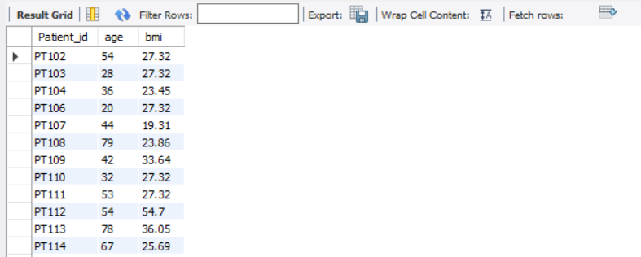
17. Create a view that displays the Patient_ids, ages, and BMI of patients.
CREATE VIEW patient_info_view AS
SELECT Patient_id, age, bmi
FROM patient;
SELECT * FROM patient_info_view;

Slide 19
18. Suggest improvements in the database schema to reduce data redundancy and improve
data integrity.
To reduce data redundancy and improve data integrity in a database schema, you can consider the following improvements:
Normalization: Apply normalization techniques to eliminate redundancy and dependency issues. Break down large tables into smaller, related tables to store data more efficiently.
2. Use Primary and Foreign Keys: Ensure that each table has a primary key to uniquely identify records. Use foreign keys to establish relationships between tables, enforcing referential integrity.
3. Avoid Storing Calculated Data: Avoid storing derived or calculated values in the database. Instead, calculate them on-the-fly when needed. This helps prevent data inconsistency and redundancy.
4. Use Enumerations or Lookup Tables: Replace repeating values with enumeration types or lookup tables. For example, create a table for gender, and reference it in the main table using foreign keys, instead of storing gender strings in each record.
5. Default Values and Constraints: Define default values for columns where appropriate. Use constraints such as NOT NULL, UNIQUE, and CHECK constraints to enforce data integrity rules.

Slide 20
8. Avoid Redundant Columns: Avoid having redundant columns that store the same information. If information can be derived from other columns, consider calculating it dynamically or creating a separate table.
7. Review Data Types: Choose appropriate data types for columns to minimize storage space. Use integer types for numerical values, and choose string types based on the expected length of the data.
8. Document and Enforce Data Standards: Establish and document data standards for naming conventions, capitalization, and formatting. Enforce these standards consistently across the database schema.
9. Audit Trails: Implement audit trails or change tracking to keep a record of modifications to the data. This enhances accountability and makes it easier to trace changes over time.
10. Indexing: Use indexes wisely to improve query performance. Index columns used frequently in search conditions, but avoid excessive indexing, as it can impact write performance.
11. Partitioning: Consider partitioning large tables to improve manageability and query performance. Partitioning can be based on a range of values, such as dates or numeric ranges.
12. Regular Maintenance: Perform regular maintenance tasks, such as database backups, integrity checks, and optimization to ensure the ongoing health and performance of the database.

Slide 21
19. Explain how you can optimize the performance of SQL queries on this dataset.
Optimizing the performance of SQL queries on a dataset involves various strategies to enhance efficiency and reduce execution times. Here are some general tips to optimize SQL queries:
Use Indexing: Create indexes on columns frequently used in WHERE clauses or JOIN conditions. Indexing speeds up data retrieval but be mindful of the trade-off with write operations.
CREATE INDEX idx_column_name ON table_name (column_name);
Optimize JOIN Operations: Use INNER JOINs instead of OUTER JOINs when possible. Ensure that columns involved in JOIN conditions are indexed.
SELECT * FROM table1 INNER JOIN table2 ON table1.id = table2.table1_id;
Avoid SELECT *: Instead of selecting all columns using SELECT *, explicitly specify only the columns needed. This reduces the amount of data transferred and can improve query performance.
SELECT column1, column2 FROM table_name WHERE condition;
Use WHERE Clause Efficiently: Filter rows as early as possible using the WHERE clause. This reduces the number of rows processed and speeds up query execution.
SELECT * FROM table_name WHERE column_name = 'value’;

Slide 22
Optimize Subqueries: Where possible, replace subqueries with JOINs. Subqueries can be less efficient, especially if they are executed for each row.
-- Subquery SELECT * FROM table1 WHERE column_name IN (SELECT column_name FROM table2 WHERE condition); -- JOIN SELECT table1.* FROM table1 JOIN table2 ON table1.column_name = table2.column_name AND table2.condition;
6. Limit and Offset Results: Use LIMIT and OFFSET to limit the number of returned rows. This is particularly important when dealing with large datasets.
SELECT * FROM table_name LIMIT 10 OFFSET 20;
Avoid Using DISTINCT Unnecessarily: Use DISTINCT only when necessary. It can be resource-intensive, especially on large datasets.
SELECT DISTINCT column_name FROM table_name;
Consider Denormalization: In some cases, denormalizing tables by duplicating certain data can improve query performance. This is a trade-off and depends on specific use cases.
Monitor and Analyze Execution Plans: Use tools to analyze query execution plans to identify bottlenecks. Adjust queries and indexes based on the analysis.
SELECT column1, column2 FROM table_name WHERE condition;
Regular Database Maintenance: Schedule regular maintenance tasks, such as index rebuilds and statistics updates, to keep the database in optimal condition.
-- Rebuild indexes ALTER INDEX ALL ON table_name REBUILD;

